Slide 1
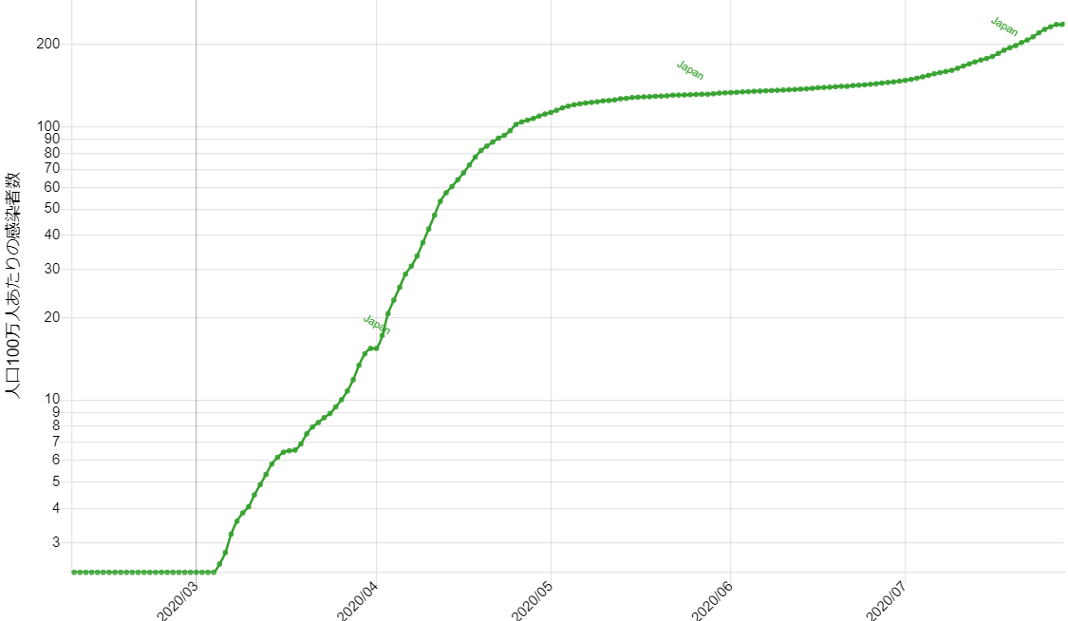
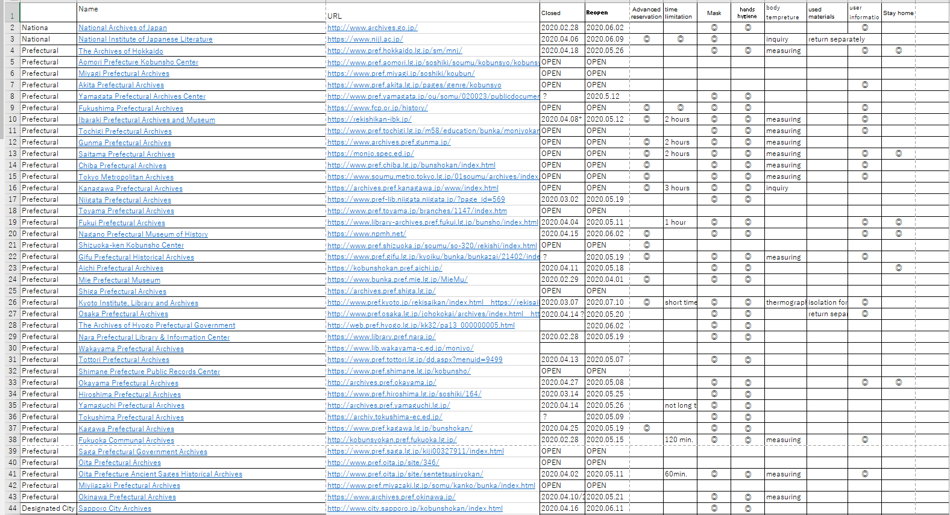
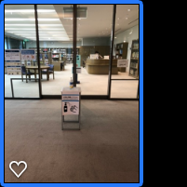
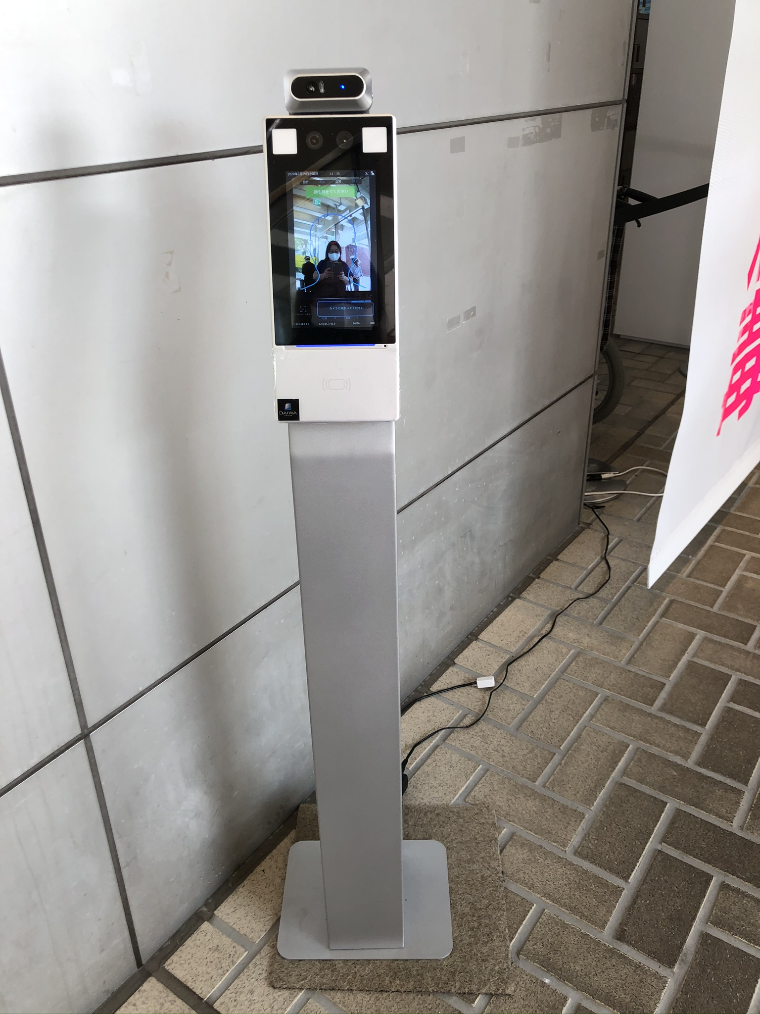
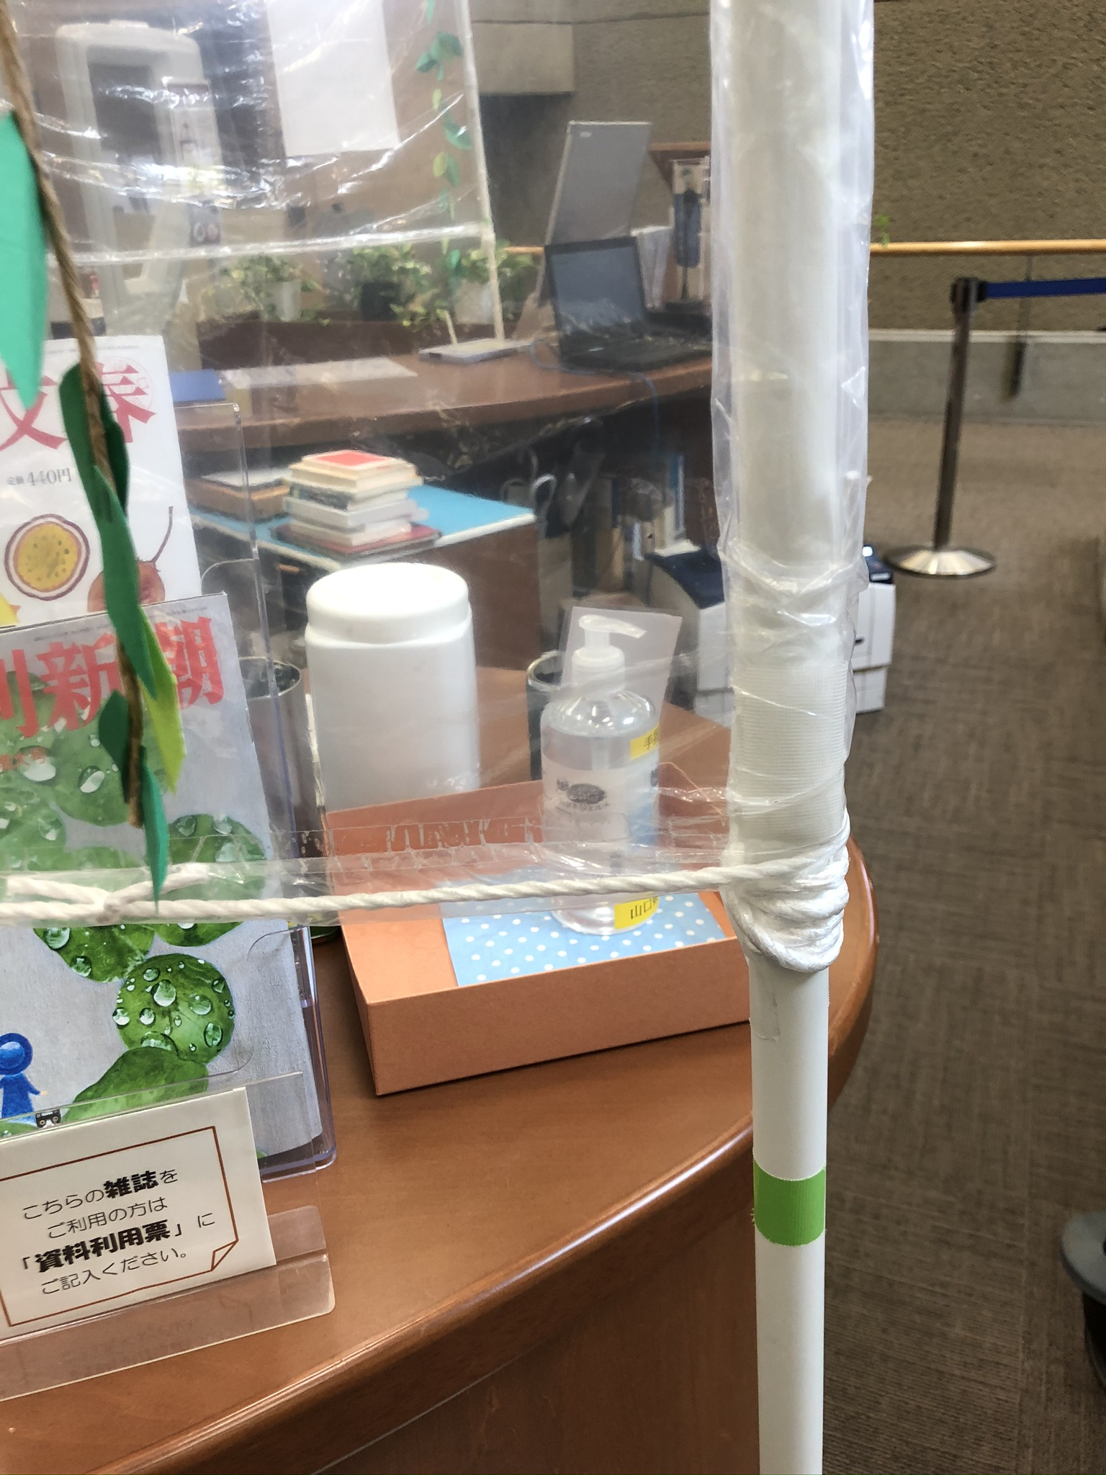
Closure and Reopening of Archives in Japan
Yayoi TSUTSUI CA ＠artemismarch on Twitter
Analysis of issues
・National Archives closed on Feb.28 and reopened on Jun.02 with Inquiry Sheet and others.
・Some prefectural or city archives keep open because they are in the governmental offices.
・Archives located in museums or libraries closed longer affected by the school closure.
・Some archives ban guests from the outside area.
・To open the archives, visitors’ wearing masks and hands hygiene are required with health check.
・National Diet Library reopened on Jun. 18 with limited visitors by a weekly lottery.
・Tokyo National Museum Research and Information Center reopened on Jun. 2 with advanced reservation. In the reading room, users should wear Nitrile rubber gloves.
Numbers of COVIDe-19 case in Japan Data from https://bit.ly/2Evs7VF
Timeline : Important dates
2020.01.16 First case Returnee from Wuhan
2020.02.xx Cruise Ship Diamond Princess
2020.02.27 Prime Minister requests closure of schools
⇒ Sudden closure of many museums in Tokyo
2020.03.24 Tokyo Olympic Games postponed
2020.04.01 New academic year starts with Online Class
Most of Universities shut down their campuses
2020.04.07/04.16 State of Emergency declared
2020.05.04 ICA etc. : COVID-19 the duty of documented
2020.05.14/05.25 State of Emergency lifted
2020.05.14 Japan Library Association released Guideline
2020.05.20 ICOM end of lockdown guideline translated
2020.07.22 Go to Travel Campaign starts
2020.07.31 Spread of infection, Tokyo counts 463 cases
https://stopcovid19.metro.tokyo.lg.jp/en
Notes:
Transition of new coronavirus COVID-19 cases per population by country
https://web.sapmed.ac.jp/canmol/coronavirus/index_e.html
List of 107 Public Archives in Japan with URL: Closed Date, Re-opening Date, Advanced reservation, Time limitation,
Requirement of wearing a mask, sanitizing hands with alcohol, measuring body temperature, Handling of used materials, Inquiry of user information, Stay home service
Photos of Prevention and Protection against COVID-19: Hiroshima Prefectural Art Museum Information Gallery, Yamaguchi Prefectural Art Museum, Yamaguchi Prefectural Library,
Hiroshima City Library Special Collection the Hiroshima-related Materials Room at Central Library, National Archives of Japan

